Slide 1
Real estate Datawarehouse project
Natan, Randy, Wen

Slide 2
Data Profiling
Data source
Zillow – Downloadable csv. File
StreetEasy - Downloadable csv. File
NYC Rolling Sales Data – Downloadable, API
Revised Notice of Property Value – API
City Realty – No downloadable resource, No API, need Script

Slide 3
Data Profiling – Data Example
What are the data contained in each data resource
Zillow – Region ID, Region Name, Zip code, Year and Month, fact: sales price
StreetEasy – Neighborhood Name, Borough, Year and Month , fact: median price
NYC Rolling Sales Data – Region ID, Neighborhood, Borough, Building type, address, sale price, sales date, fact: sales price
Revised Notice of Property Value – Borough, block, lot, address, market value, assessed value, fact: price(value)
City Realty – Address Neighborhood, Beds Price, Date, Building types, fact: price

Slide 4
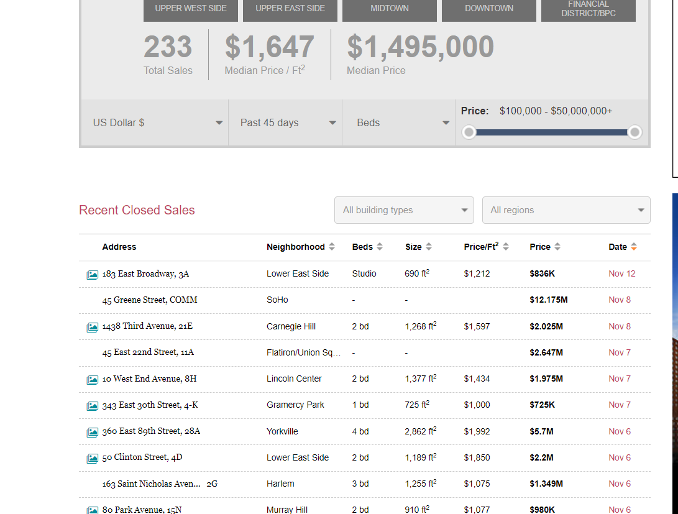
Data Profiling –Problem
The data from City Realty have high quality.
However, it is very Dynamic
Our team need to Script data from Website

Slide 5
Conceptual Architecture
Infrastructure
One Raw Datawarehouse – Store raw data extract from the sources
One Conformed Datawarehouse – Star schema
One backup Datawarehouse in different security group

Slide 6
Schema, Dimension, and fact
Schema
One Star schema
Dimension
Time - Year, Month, Date
Location - Borough, Neighborhood, Address, Zip Code
Building type – Rent, Condo, Coop
Fact
Price

Slide 7
Conceptual Architecture – Challenge
Level of data (Year Month, or Date?)
Deal with duplicated data from different data source
How to deal with the slowly changing data

